Slide 1
Chongqing University of Technology
ATAI
Advanced Technique of Artificial Intelligence
Chongqing Unive
A Label Dependence-aware Sequence Generation Model for
Multi-level Implicit Discourse Relation Recognition
Code：https://github.com/nlpersECJTU/LDSGM
（AAAI-2022)
Reported by Zicong Dou

Slide 2
Chongqing University of Technology
ATAI
Advanced Technique of Artificial Intelligence
Chongqing University of Technology
1. Introduction
2. Approach
3. Experiments

Slide 3
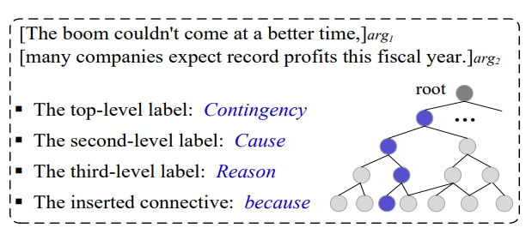
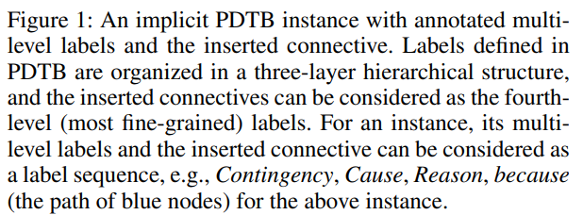
Introduction
这种繁荣来得正是时候，
依据PDTB的任务定义，篇章关系类型主要分为四大类：比较关系（Comparison）、偶然关系（Contingency）、扩展关系（Expansion）、时序关系（Temporal）。
许多公司预计本财年利润将创历史新高。
• We consider multi-level IDRR as a label sequence generation task.
• We propose a label dependence-aware sequence generation model. Both its encoder and decoder, combined with the mutual learning enhanced training method, can fully leverage the label dependence for multi-level IDRR.

Slide 4
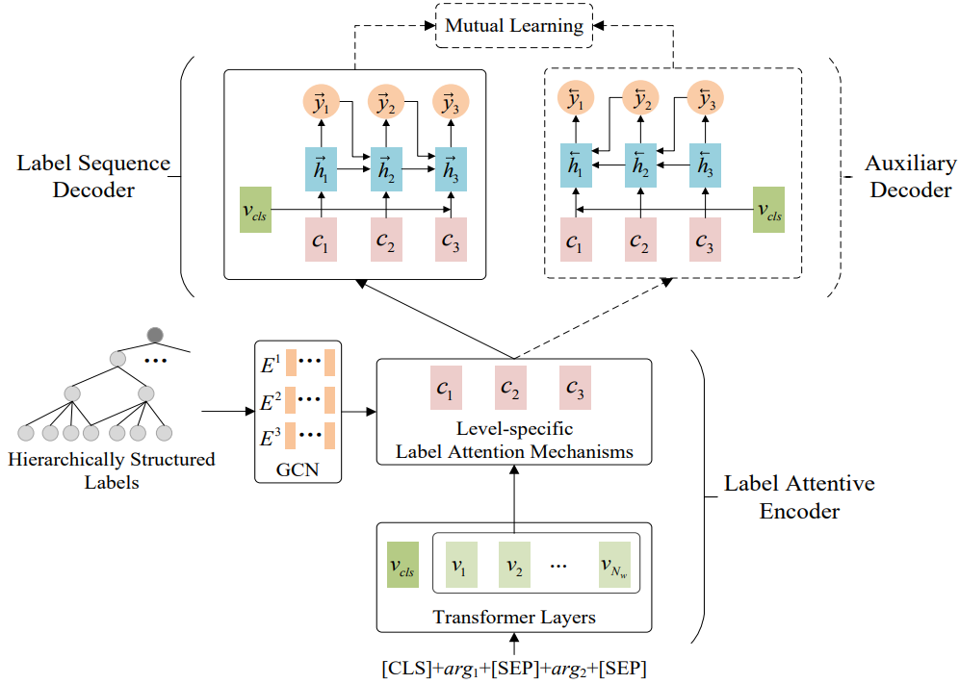
Approach

Slide 5
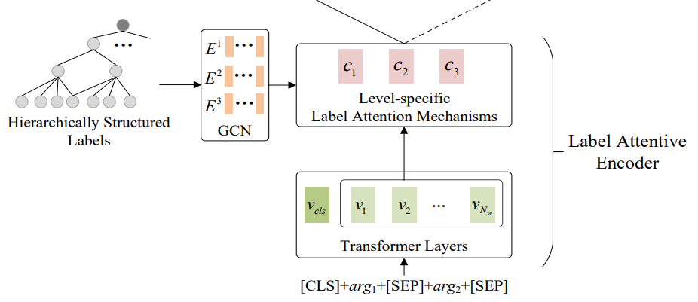
Approach
Label Attentive Encoder
local and global representations
Use GCN to obtain better label embeddings
label attention mechanisms to extract learn contexts

Slide 6
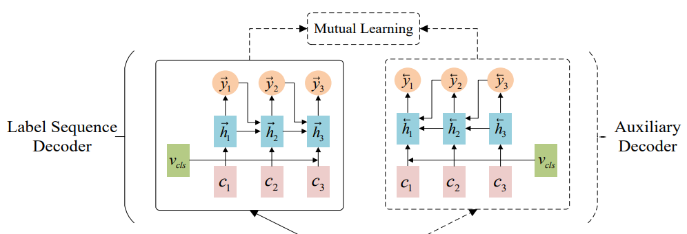
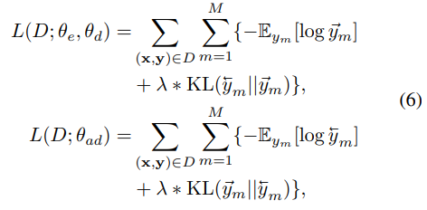
Approach
Label Sequence Decoder
Mutual Learning Enhanced Training

Slide 7
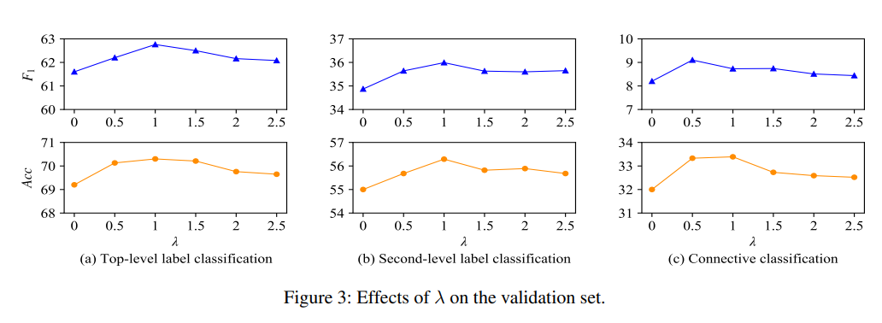
Experiments

Slide 8
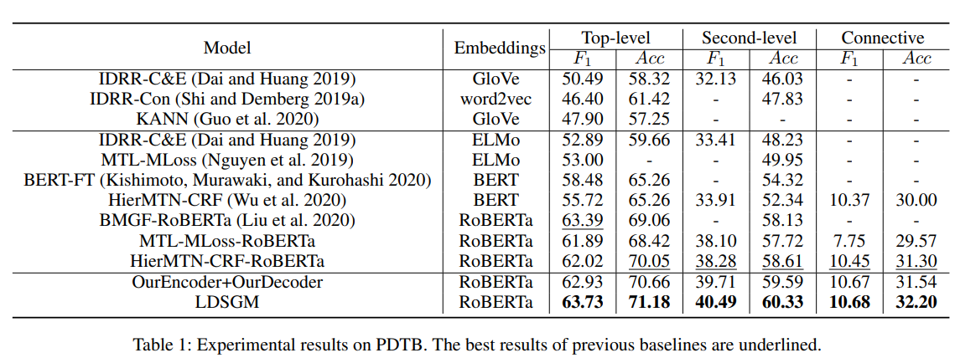
Experiments

Slide 9
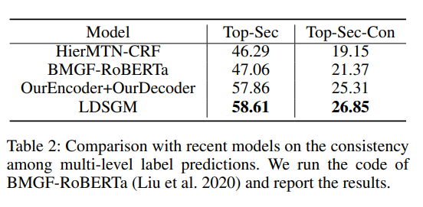
Experiments

Slide 10
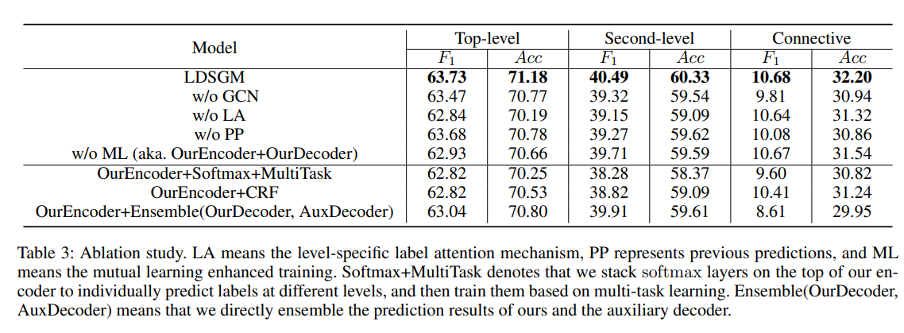
Experiments

Slide 11
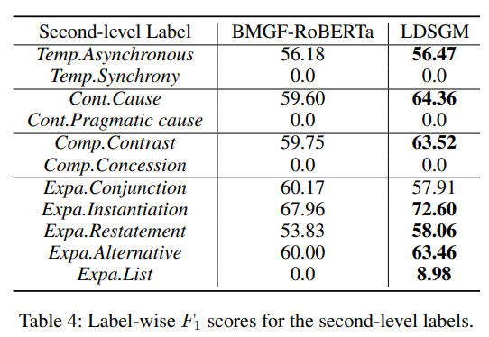
Experiments

Slide 12
Thank you！

